Slide 1
Adventures in Data Munging
Computers and Consumer Reports

Slide 2
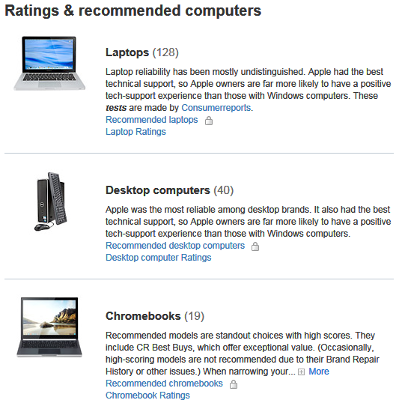
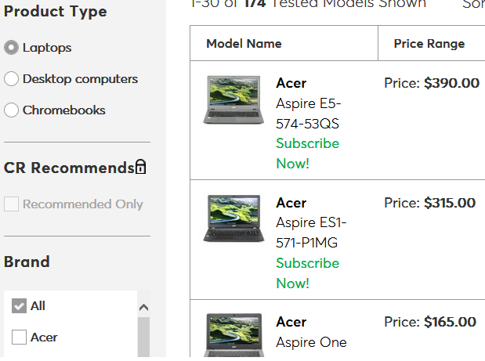
Getting The Data
Site organization: Level I:
Selenium
Scrapy Spider
Selenium

Slide 3
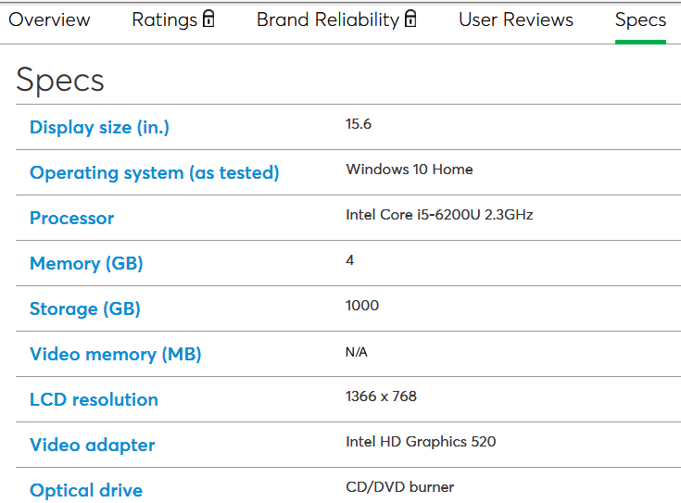
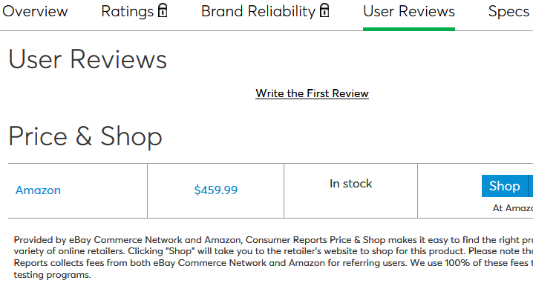
Site Level II
Sometimes a Link is not just a link:
https://www.consumerreports.org/products/laptop/acer-aspire-e5-574-53qs-385910/specs
https://www.consumerreports.org/products/laptop/acer-aspire-e5-574-53qs-385910/user-reviews

Slide 4
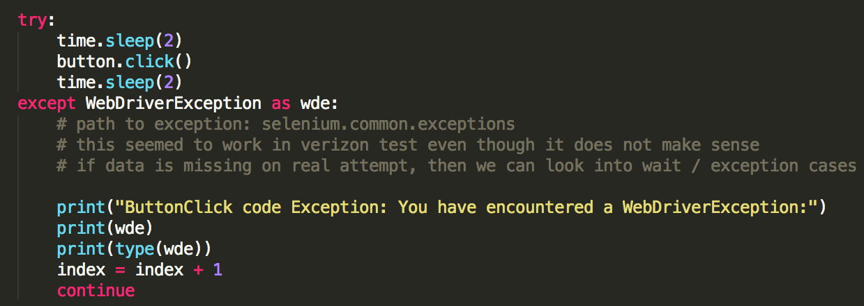
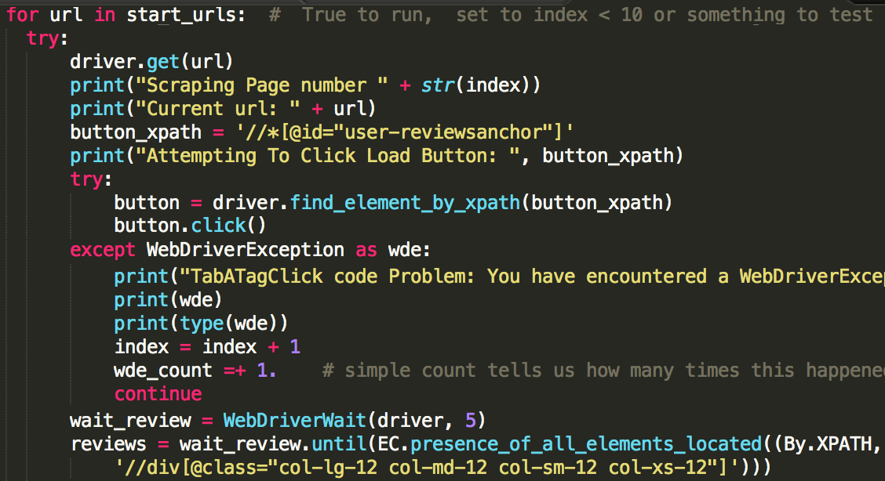
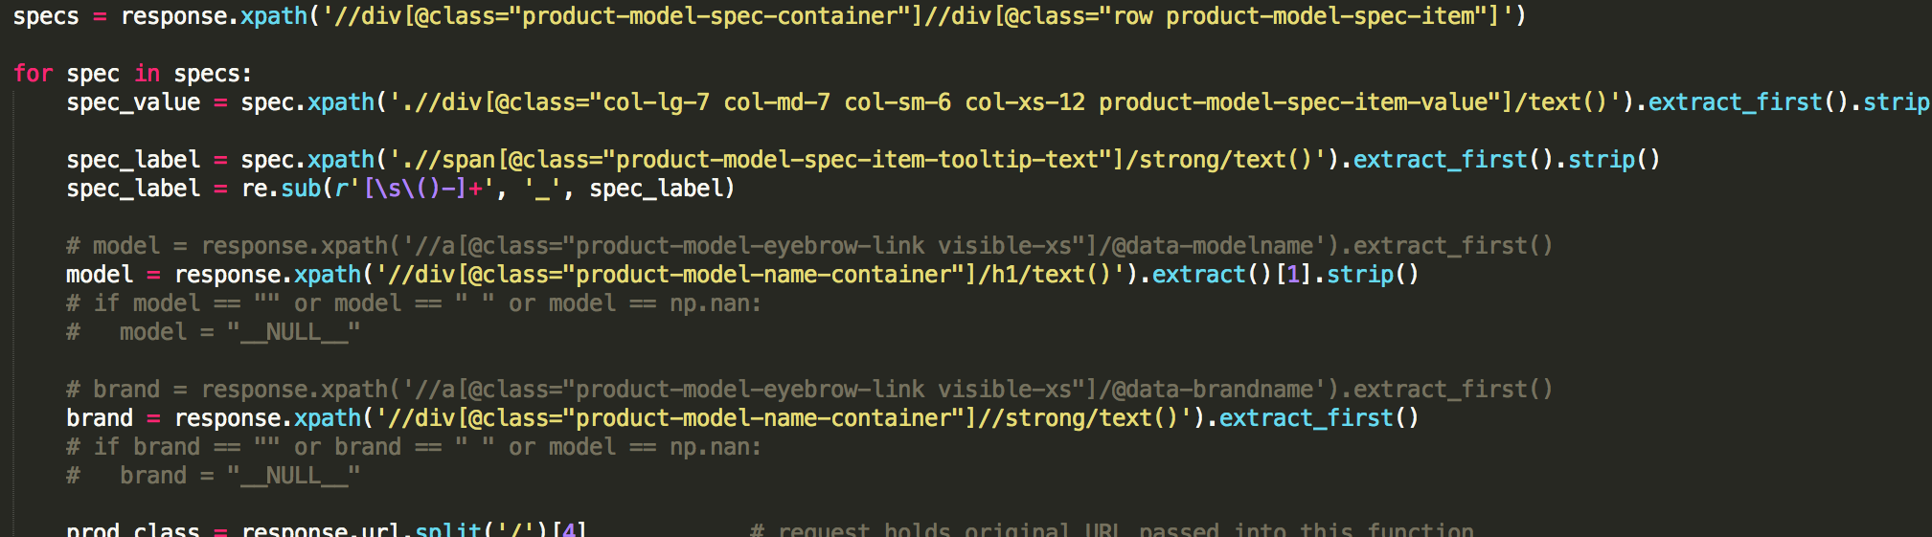
What Works For One Part of A Site Doesn’t Always Work For Another
Selenium
Selenium Again
Scrapy Spider

Slide 5
Modular Iterative Approach
Get All The Data Up Front
Some Transformation with Scrapers for Some Known Patterns
Create CSV Spreadsheet Each Step Of The Way
Load into R or Jupyter Module – Whichever One “Feels Faster”
Generate Sheet of Data
Use Data In Analysis
Go Back to Source and Do It All Again
You Don’t Build Everything You Want But You Do Build Something
Each Sheet Along The Way Allows You to Pick Up Where You Left Off Without Rerunning Code

Slide 6
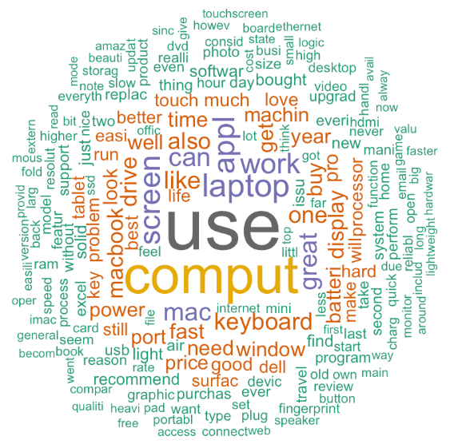
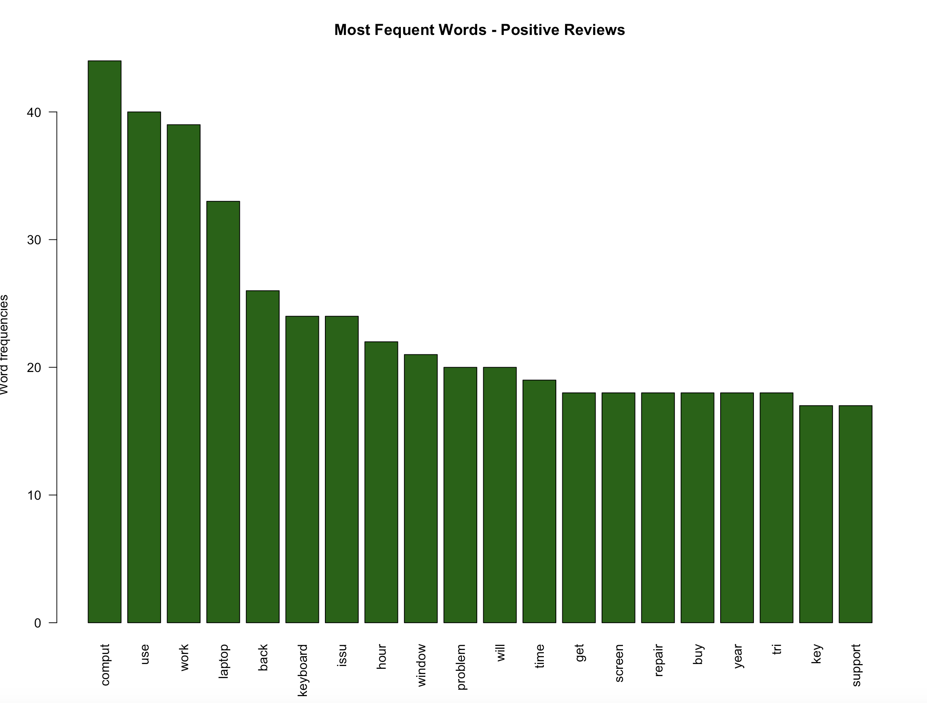
Word Clouds: Review Data Positive Reviews
Top 25 By Frequency:

Slide 7
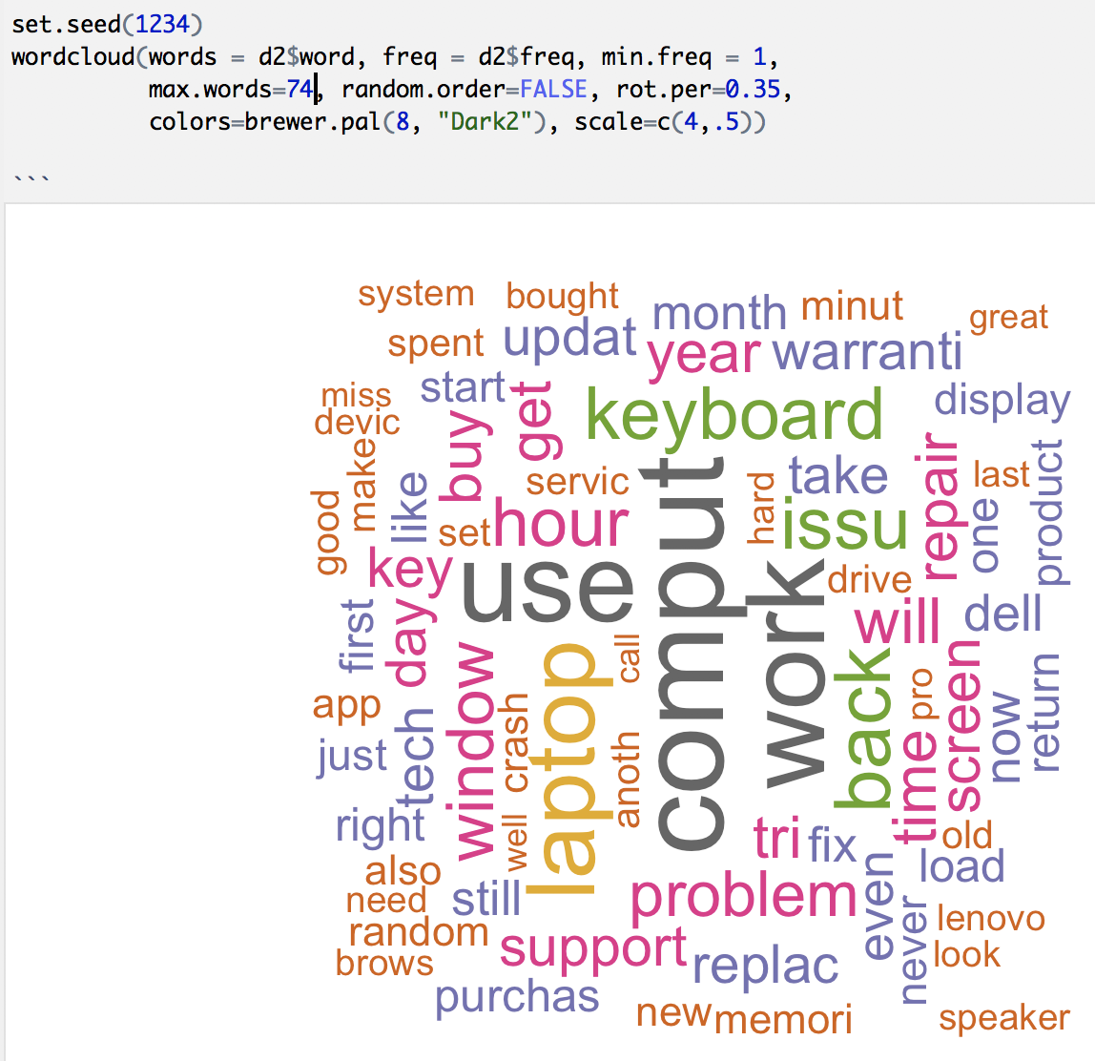
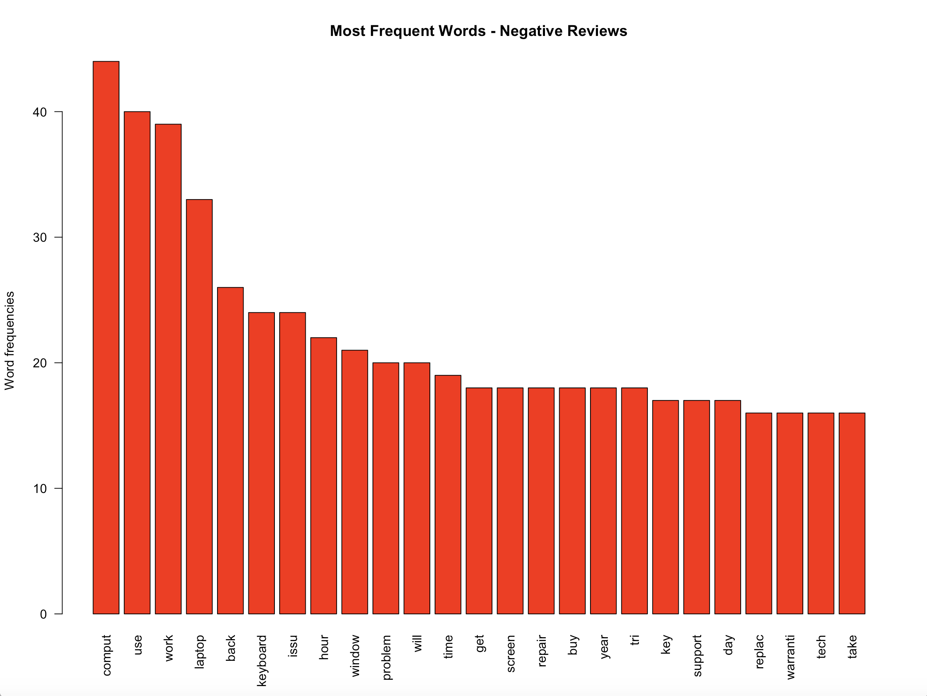
Word Clouds: Review Data Negative Reviews
Top 25 By Frequency:

Slide 8
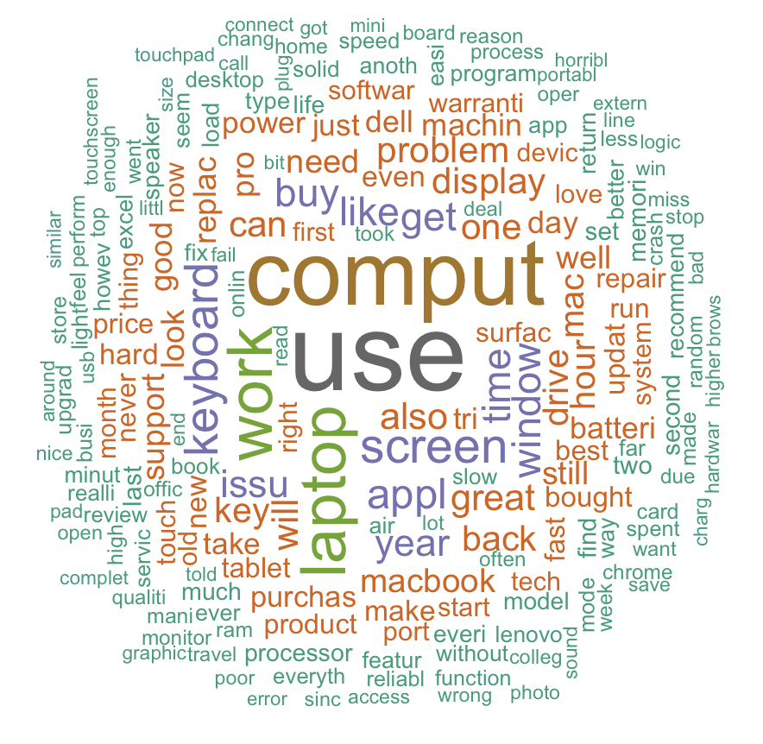
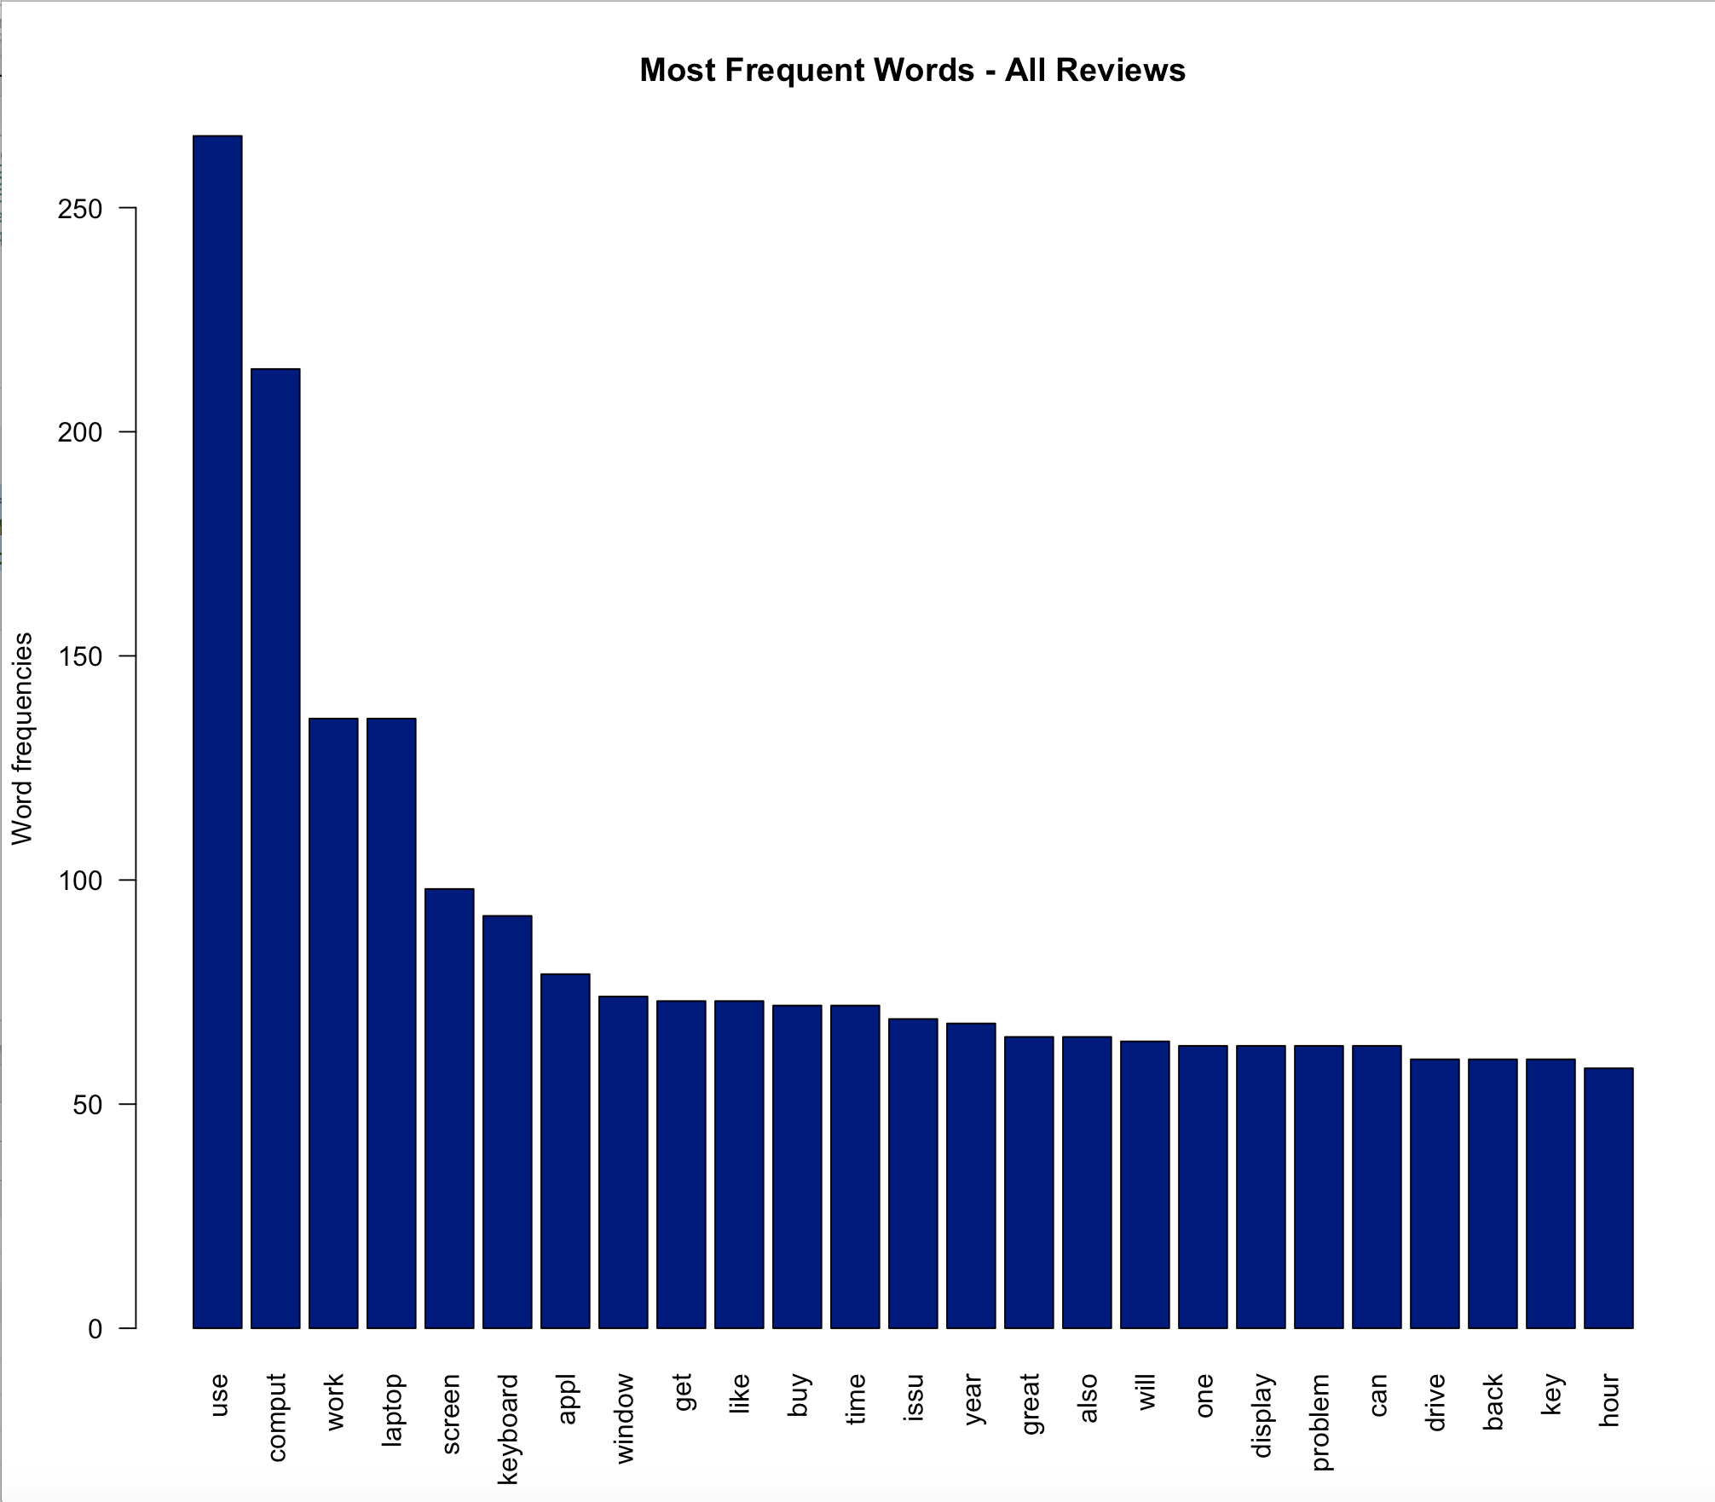
Word Clouds: Review Data All Reviews
Top 25 By Frequency:

Slide 9
Analysis of Specifications With MatPlotLib and Seaborn
A Jupyter Notebook Saved to HTML provides a convenient way to tell this story:
Source: “TMWP_CR_Spec_TableAnalysis1.ipynb”
In HTML: “TMWP_CR_Spec_TableAnalysis1.html”
High Level – We Look At:
New Features – Coverage by Consumer Reports
Little Bit About RAM and Price
53 Variables were collected for 268 Desktop, Laptop, and Chromebook Products were collected, but each one, even with work performed inline by scrapers, still required work to prepare it for analysis.

